Slide 1
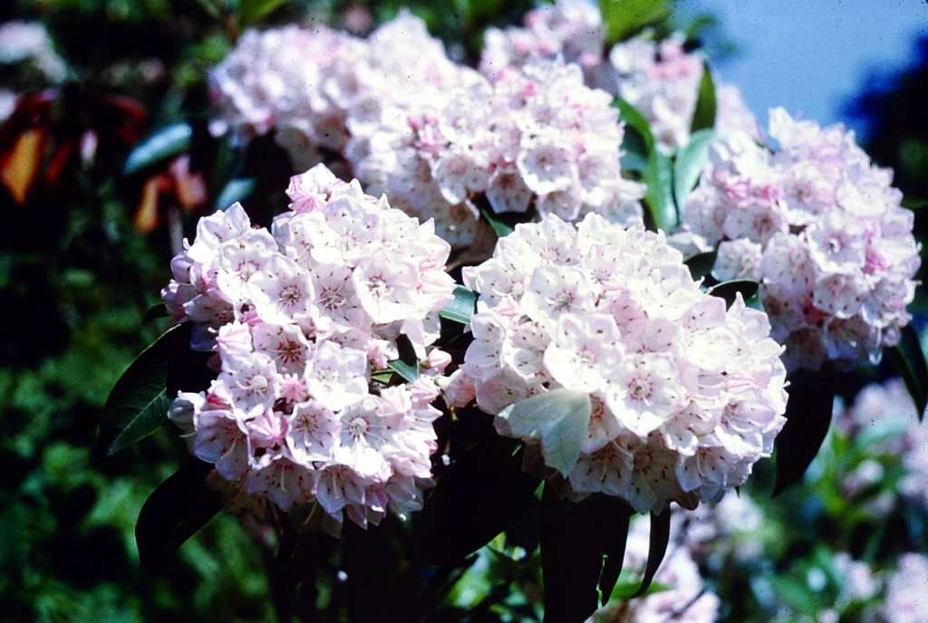

MOUNTAIN LAUREL BOOK AWARD
formerly Pennsylvania Young Reader’s Choice Award
2025-2026 Nominees
Grades K-3
Notes:
In April 2025, the Pennsylvania School Librarians Association formally changed the name of the Pennsylvania Young Reader’s Choice Award to the Mountain Laurel Book Award. Mountain laurel is the Pennsylvania state flower. There are 15 nominees. Which one will be your favorite?
(Background picture from https://cdn2.picryl.com/photo/2010/01/01/mountain-laurel-6d2bcc-1024.jpg)

Slide 2
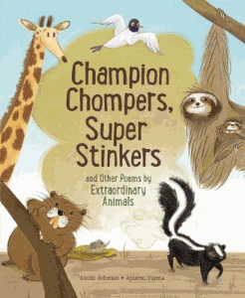
Notes:
Champion Chompers, Super Stinkers and Other Poems by Extraordinary Animals by Linda Ashman; Aparna Varma, illustrator (RL: 6.8)
Can you guess which animal builds the biggest nest? Is the fastest long-distance runner? A great artist? How about the stinkiest? The animals will give you the chance to guess on one page and then tell you about themselves on the next!
Author Website: https://www.lindaashman.com/

Slide 3

Notes:
One Million Trees: A True Story by Kristen Balouch (RL: 2.4)
Imagine that after school one day, your parents handed you a suitcase and a packing list and off you flew to Canada. That’s what happened to the author of One Million Trees when she was 10 years old. Her Californian family traveled to British Columbia for “tree planting season.” Joining a crew of 24 Canadians, they planted ONE MILLION TREES. Yes, there were bug bites, scratches and lots of mud, but there was also swimming, playing, living in a tent and a sense of satisfaction for a job well done.
Author Website: https://www.kristenbalouch.com/about-me
Ten Million Trees for Pennsylvania Project: https://tenmilliontrees.org/
Arbor Day Foundation: https://www.arborday.org/youth-education

Slide 4

Notes:
Stella & Marigold by Annie Barrows; Sophie Blackall, illustrator
Stella could remember only four things from when she was little, but once Marigold was born, she remembered everything! Stella and Marigold are sisters who are four years apart and live in the bottom half of a house with their mother and father. In each of the seven short stories in the book, you will enjoy the many ways they use their imaginations for adventures, sharing and caring.
Author Website: http://anniebarrows.com/about/
Illustrator Website: https://www.sophieblackall.com/

Slide 5

Notes:
Carla's Glasses by Debbie Herman; Sheila Bailey, illustrator
Oh, the dreaded vision-screening day! No one wants to wear glasses…well, except for Carla. She likes to be different and wants to be THE ONE who needs glasses. All different styles and colors come to mind. She even makes her own glasses! Her friend Buster doesn’t want glasses. Who will end up with a new pair of glasses?
Author Website: https://www.debbieherman.com/about-5
Coloring Page: https://flashlightpress.com/wp-content/uploads/2024/03/Carla-and-Her-Cat-.pdf
DIY Glasses: https://www.firstpalette.com/craft/paper-eyeglasses.html

Slide 6
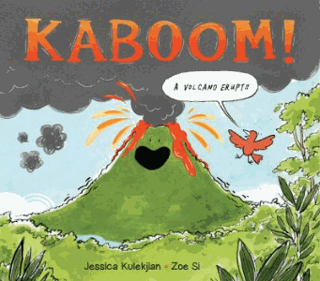
Notes:
Kaboom!: A Volcano Erupts by Jessica Kulekjian; Zoe Si, illustrator (RL: 4.2)
Hey everyone! If you're curious about the amazing—and sometimes scary—world of volcanoes, then Kaboom!: A Volcano Erupts by Jessica Kulekjian is a book you're going to want to check out.
This isn't your average nonfiction book. It's packed with eye-popping illustrations and vivid details that make the violent, fiery eruption of a volcano come to life. Kulekjian takes us step-by-step through how a volcano forms and what happens when it finally erupts, giving us a front-row seat to one of nature's most explosive events!
Author Website: https://jessicakulekjian.com/
Teacher Resources: https://www.kidscanpress.com/wp-content/uploads/2023/04/KaboomAVolcanoErupts_2827_teaching.pdf

Slide 7
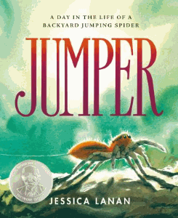
Notes:
Jumper: A Day in the Life of a Backyard Jumping Spider by Jessica Lanan (RL: 2.3)
If you've ever wondered what it would be like to see the world through the eyes of a tiny but incredibly cool creature, then Jumper: A Day in the Life of a Backyard Jumping Spider is the book for you. This story takes you on an epic, up-close adventure as you follow a day in the life of a jumping spider named Jumper. Plus, you get to see the world from Jumper's tiny point of view, which makes everything—from a blade of grass to a garden flower—feel like a giant jungle!
Author Website: https://jessicalanan.com/

Slide 8

Notes:
Mr. Fox's Game of "No!" by David LaRochelle; Mike Wohnoutka, illustrator
I guarantee that you will never read “a funnier, better written, more beautifully illustrated book than this one!” Do you believe me? If you answered “no,” then you are ready to read Mr. Fox’s Game of “No!,” where all you have to do to play is just answer NO to every question Mr. Fox asks. Get ready to play along with this funny, ok, the funniest book ever written!
Author Website: https://davidlarochelle.com/
Illustrator Website: https://www.mikewohnoutka.com/
Extension Activities: https://davidlarochelle.com/childrens_books/mr_fox_game_of_no/

Slide 9
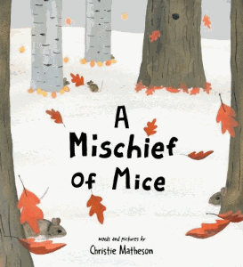
Notes:
A Mischief of Mice by Christie Matheson
Let’s play a guessing game. What is a group of giraffes called? A tower. How about a group of flamingos? A flamboyance. And what is a group of mice called? Yes, a mischief. In this mystery-type book about a mischief of mice gone missing, many different animals take part in figuring out where they may have disappeared to. Along the way, you will learn the unusual names of murders…I mean…skulks…I mean…well, you get it…groups of living creatures.
Author Website: https://christiematheson.com/about

Slide 10

Notes:
Reggie: Kid Penguin by Jen de Oliveira (RL: 2.4)
Do you like school picture day or are you like Reggie whose pictures NEVER turn out right! Does making a village for Roly-polies with your friends at recess sound like fun? Do you need ALL your stuffies in your bed before you can sleep at night? If these stories sound familiar, you will love reading the short stories about Reggie in this graphic novel.
Author Website: https://reggiecomic.com/about-2/
Activity Pages: https://reggiecomic.com/wp-content/uploads/2023/08/Reggie-Kid-Penguin-Activity-BUNDLE.pdf

Slide 11
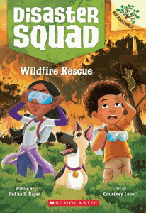
Notes:
Wildfire Rescue (Disaster Squad) by Rekha S. Rajan; Courtney Lovett, illustrator
Can you picture your family helping out in a natural disaster like a wildfire? What job would you do? Your parents? Your older brother or sister? Well, in this new series, the Jackson family does just that…puts themselves in the path of disasters to help others. A wildfire is no joke, but the Jacksons arrive on the scene to aid the animals, the environment, and the community.
Author Website: https://rekhasrajan.com/books
Wildfire Basics Video: https://wvia.pbslearningmedia.org/resource/idptv11.sci.ess.earthsys.d4kwfir/wildfire/

Slide 12
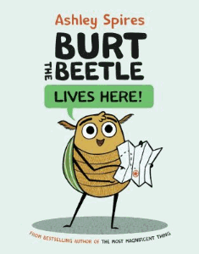
Notes:
Burt the Beetle Lives Here! by Ashley Spires (RL: 2.2)
Meet Burt- he’s a June bug with sticky arms and a fondness for hugs. All Burt the beetle wants to do is settle down and find the perfect home for himself. Should he build his home out of silk like monarch butterflies? Or make it out of wood fibers and saliva like wasps? Or maybe he could just move into a human home? What does the perfect home for a June beetle look like anyways?
Author Website: https://www.ashleyspires.com/

Slide 13

Notes:
The Most Magnificent Maker's A to Z by Ashley Spires (RL: 2.6)
“B is for brainstorm! I is for IDEA! P is for patience! M is for mistakes!” You won't make a mistake when reading this alphabetical journey that focuses on imagination and creativity. Learn all the words important to growth mindset and making so you can create a magnificent thing.
Author Website: https://www.ashleyspires.com/

Slide 14

Notes:
José Feeds the World: How a Famous Chef Feeds Millions of People in Need Around the World by David Unger; Marta Álvarez Miguéns, illustrator
This is the true story of a boy who loves to cook and grows up to be a chef. The story doesn’t stop there though, he sees that many people around the world are going hungry. What can one person do? You’d be surprised!
Author Interview: https://www.publishersweekly.com/pw/by-topic/childrens/childrens-authors/article/94172-in-conversation-erin-frankel-and-david-unger.html
Illustrator Website: https://www.martalverez.com/

Slide 15
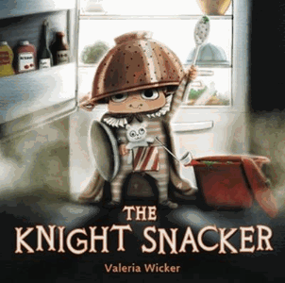
Notes:
The Knight Snacker by Valeria Wicker (RL: 4.0)
What is a boy to do who is sooooo hungry? Well, if he would have eaten his dinner, yummy Fusion Fondue, even though it is…ummmm…yucky…he wouldn’t be sooooo hungry. Sir Julian braves the dark in search of a nighttime snack.
Author Website: https://valeriawicker.com/

Slide 16

Notes:
Dear Street by Lindsay Zier-Vogel; Caroline Bonne Müller, illustrator (RL: 3.5)
What do you like about your neighborhood? About your school? The character in this book hears people complaining and missing the good things that surround them. She comes up with a plan to help people notice the good. You’ll hear about her plan and maybe we can try it too!
Author Website: https://lindsayziervogel.com/
Educators Guide: https://lindsayziervogel.com/wp-content/uploads/2023/10/Dear-Street-Educators-Guide.pdf

